Slide 1
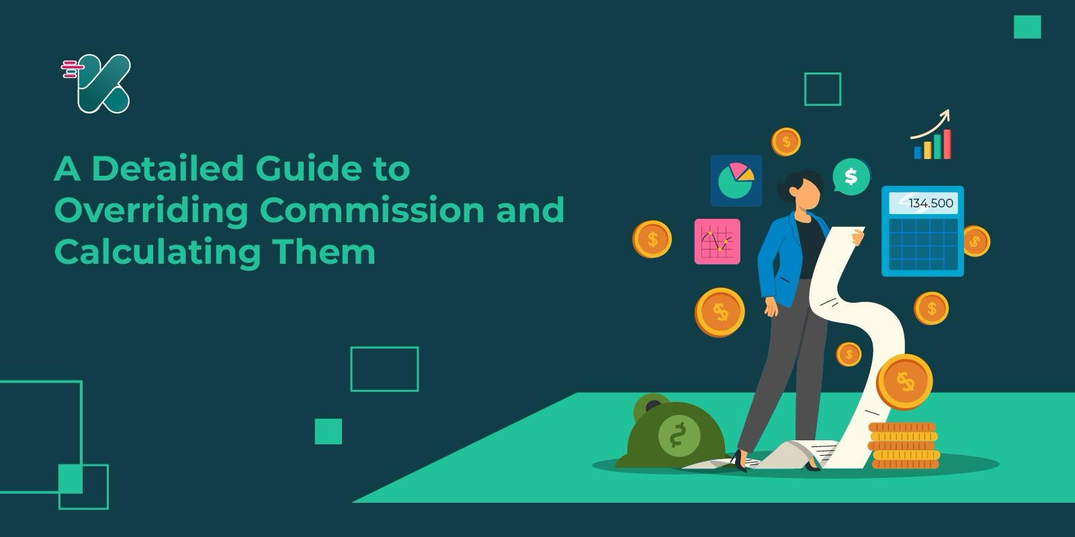

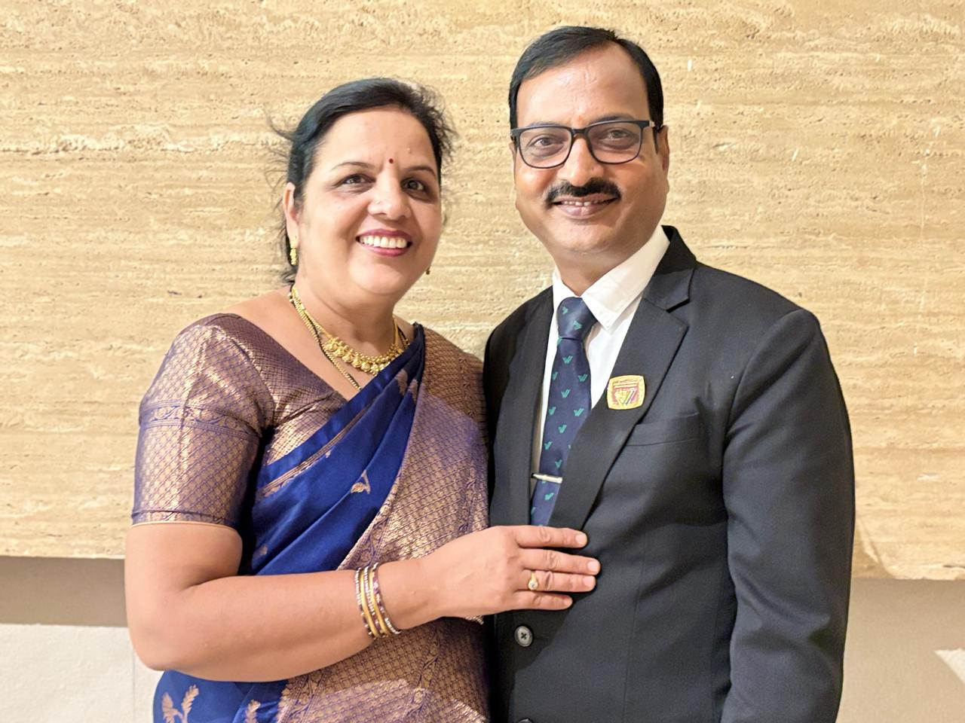

Importance of LOB
Presentation By :- Satyanarayan & Sheela Kulkarni

Slide 2
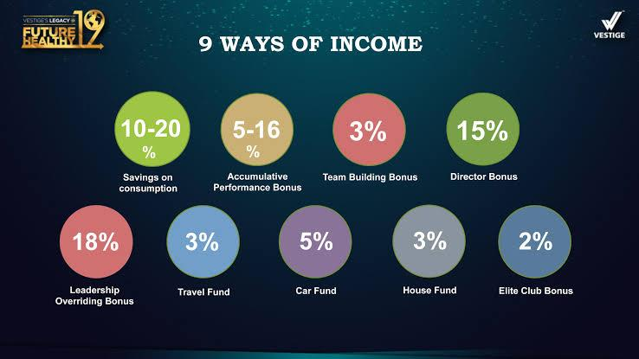
10-30
%

Slide 3

1. What is LOB?
LOB = Leadership Overriding Bonus
Vestige distributes income in 9 ways – LOB is one of the most important
LOB decides your bonus size and long-term income
A) Creating leadership in your team
B) Training, supporting, and generating volume (PV)
C) System duplication

Slide 4
What is the Criteria for LOB?
You should be a Silver Director
You should generate at least 5625 (say 6000) PV from a single leg

Slide 5

Importance Of LOB
One-time effort, lifetime income
Retailing gives income – LOB fulfills dreams
LOB is like an ATM
More ATMs = More income
Don’t be the boss – Create leaders and earn LOB

Slide 6

Impact of LOB on Your Business
Highest % in Vestige income
High PV generated
Strong impact on your bonus
MLOB = Big bonus, Profitable, Long-term, Sustainable, Duplicable, Secure
LOB builds legacy, royalty, and wealth

Slide 7

If You Don’t Create LOB
More effort, less result
Big dreams, small achievements
Frustration and loss of confidence
Team may leave, blame you or system
Get distracted, look for other opportunities
Eventually quit the business

Slide 8
Without LOB
With LOB
Silver Director
Silver Director
2001PV
6000PV
Side Volume :- 1800PV
Side Volume :- 2100PV
Bonus :- 5000/-
Bonus :- 25000/-

Slide 9
Without LOB
With LOB
Gold
Director
Gold Director
2001PV
6000PV
6000PV
2001PV
Side Volume :- 1500PV
Side Volume :- 1800PV
Bonus :- 8000/-
Bonus :- 40000/-

Slide 10
Without LOB
With LOB
Crown Director
Crown Director
2000PV
2000PV
6000 PV
6000 PV
2000PV
2000PV
6000 PV
6000 PV
2000PV
2000PV
6000 PV
6000 PV
Bonus :- 20000/-
Bonus :- 1,00,000/-

Slide 11
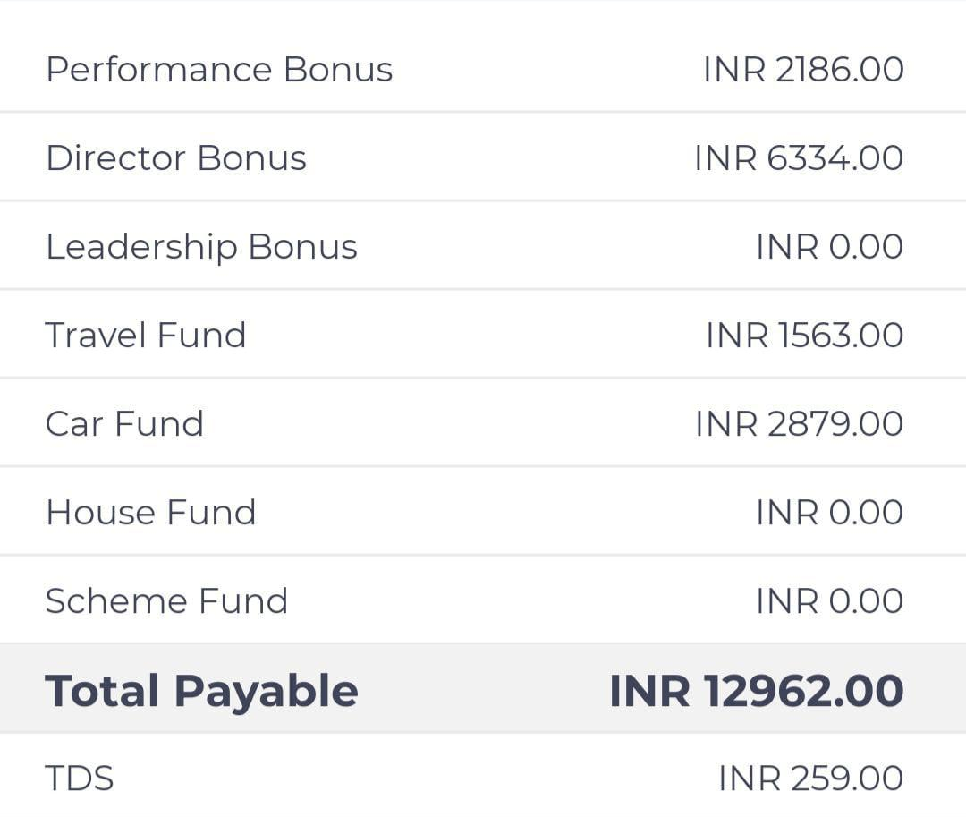
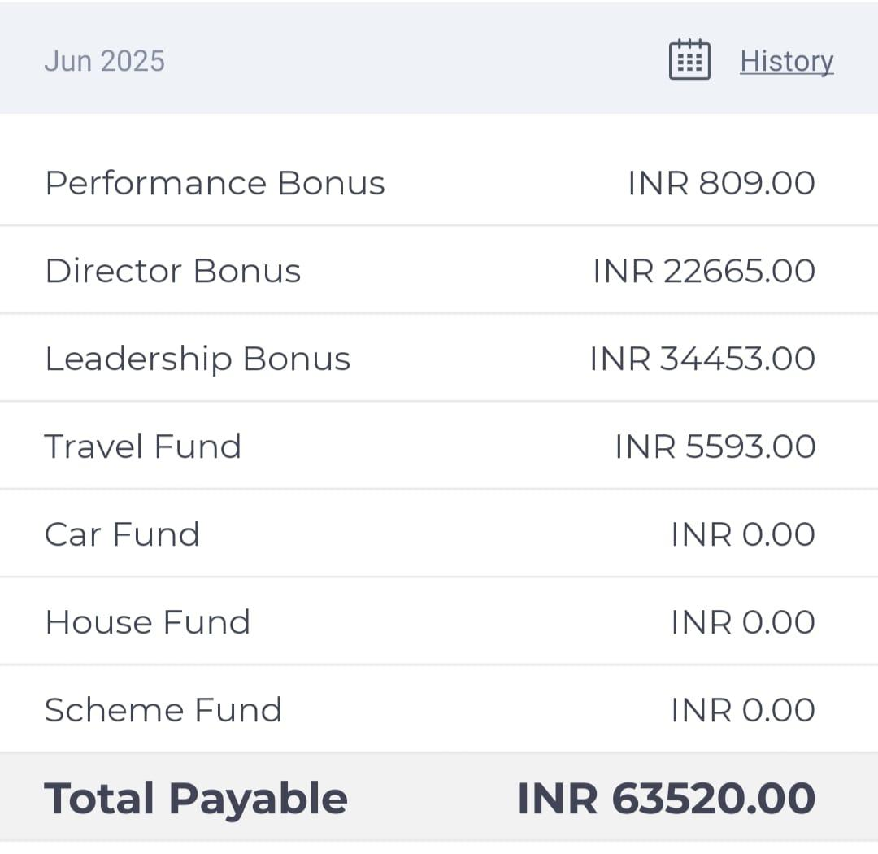
Star Without LOB
Star With LOB

Slide 12
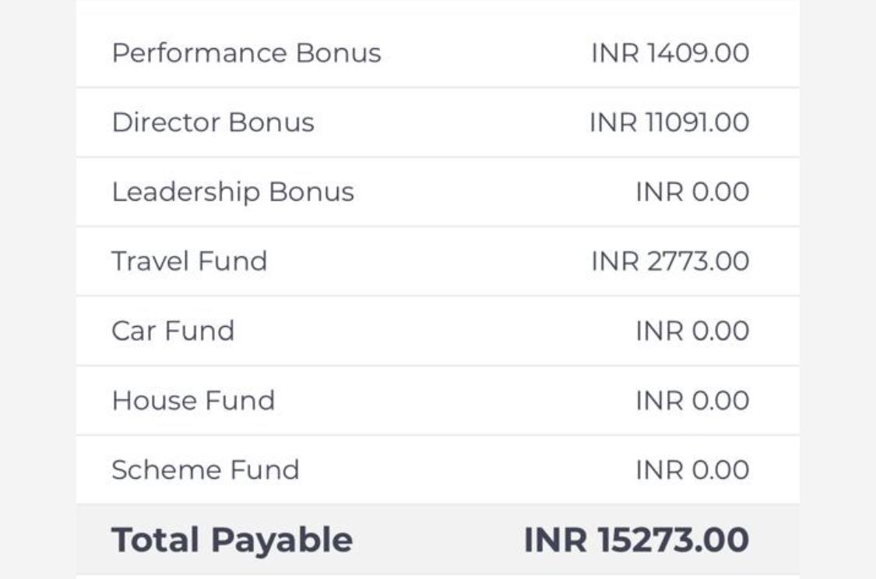
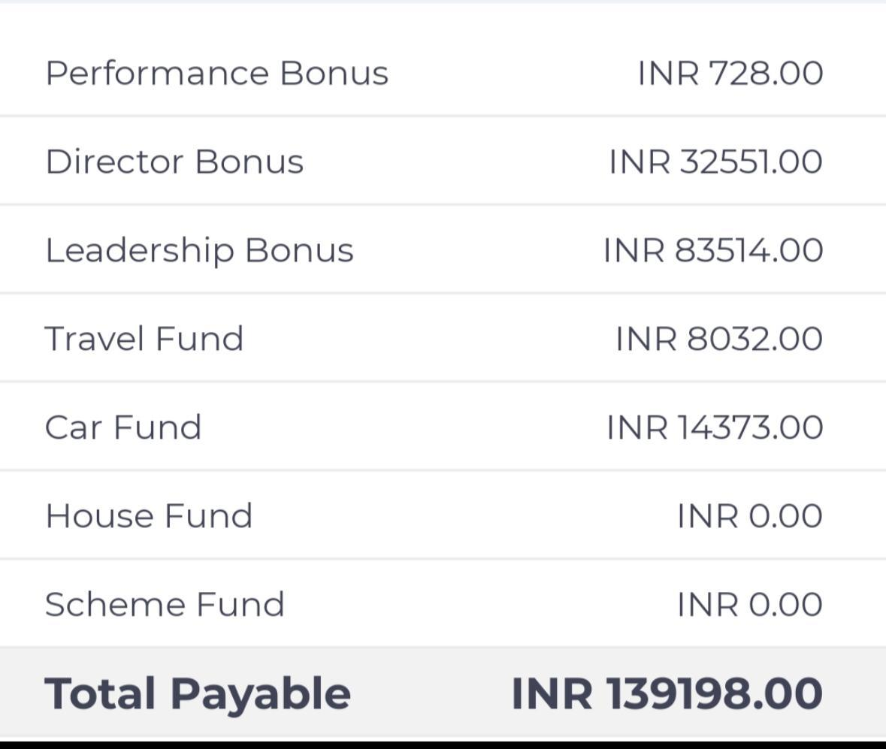
Crown Without LOB
Crown With LOB

Slide 13
How to Achieve LOB?
Build strong leg structures
Create duplication and support systems
Help team grow through events and recognition
Focus on training and leadership development

Slide 14
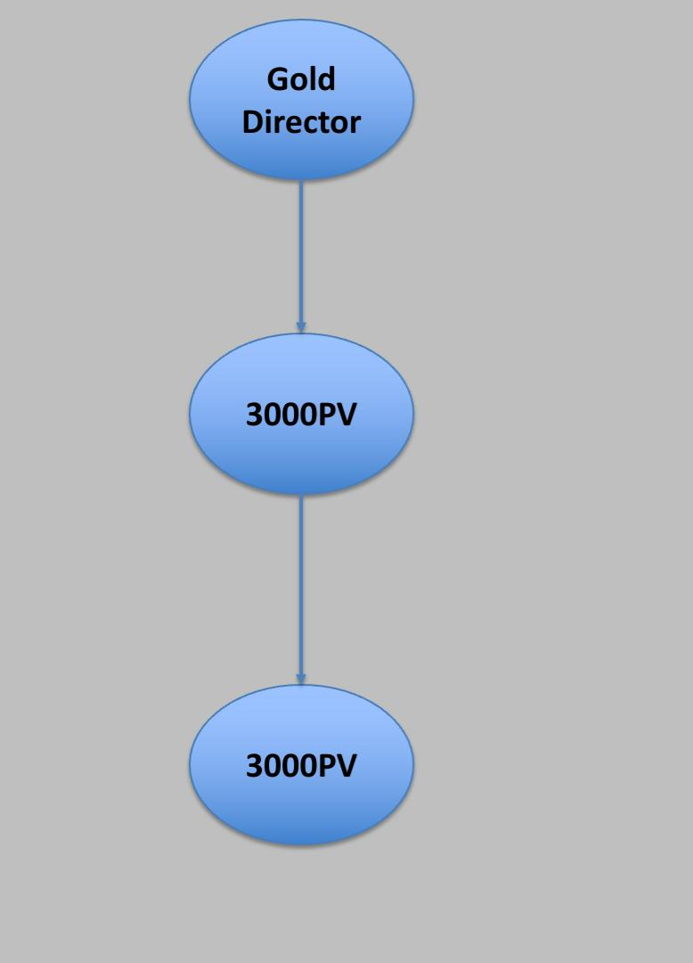
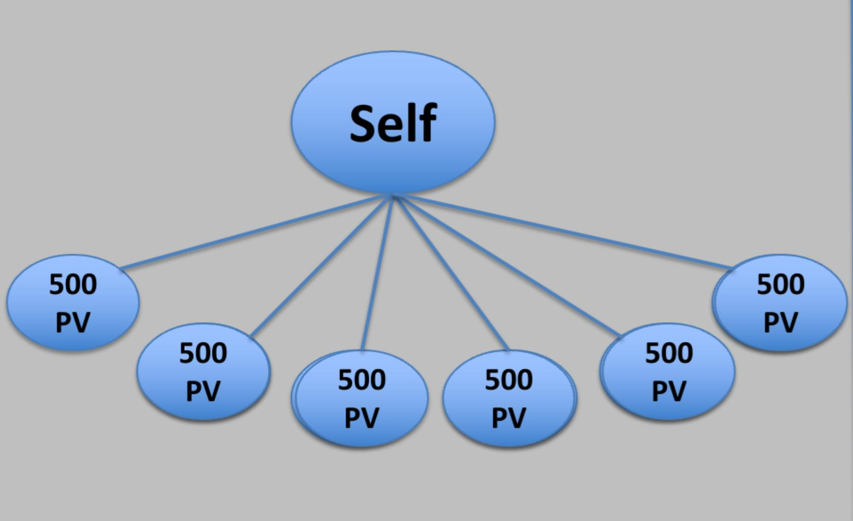
How to Achieve LOB?
YOU
LTD
LTD
YOU
Focus on 500 PV Circle
Go-Getter
(Bronze With 3000PV)
CORE
LOB

Slide 15

‘‘Retailing gives income,
LOB gives freedom’’

Slide 16

LOB Is The Key To Success

Slide 17


